Slide 1


CURA - HMS

Slide 2

AGENDA

Slide 3
AGENDA
Improvements from Professor Feedback
Team Member Roles and Responsibilities
Problem Statement
Project description
Personas
MVP
Technologies
Conceptual Architectural Diagram
Sprint 3 Recap
Product Backlog
Sprint Backlog
Metrics
Retrospective
Sprint 5

Slide 4
Improvements FROM PROFESSOR FEEDBACK
Feedback
Improvements
Story Points Missing.
Mention Diagram name.
Story points mentioned to every user story.
Architectural Diagram mentioned.

Slide 5




MEET OUR TEAM
SAI TEJA KORIBILLI
BINDU VALISETTY
KULDEEP KALUVALA
MOUNIKA THALLA
SCRUM MASTER
DATA BASE ADMINISTRATOR
UI/UX DEVELOPER
DEVELOPER
PROJECT MANAGER

Slide 6
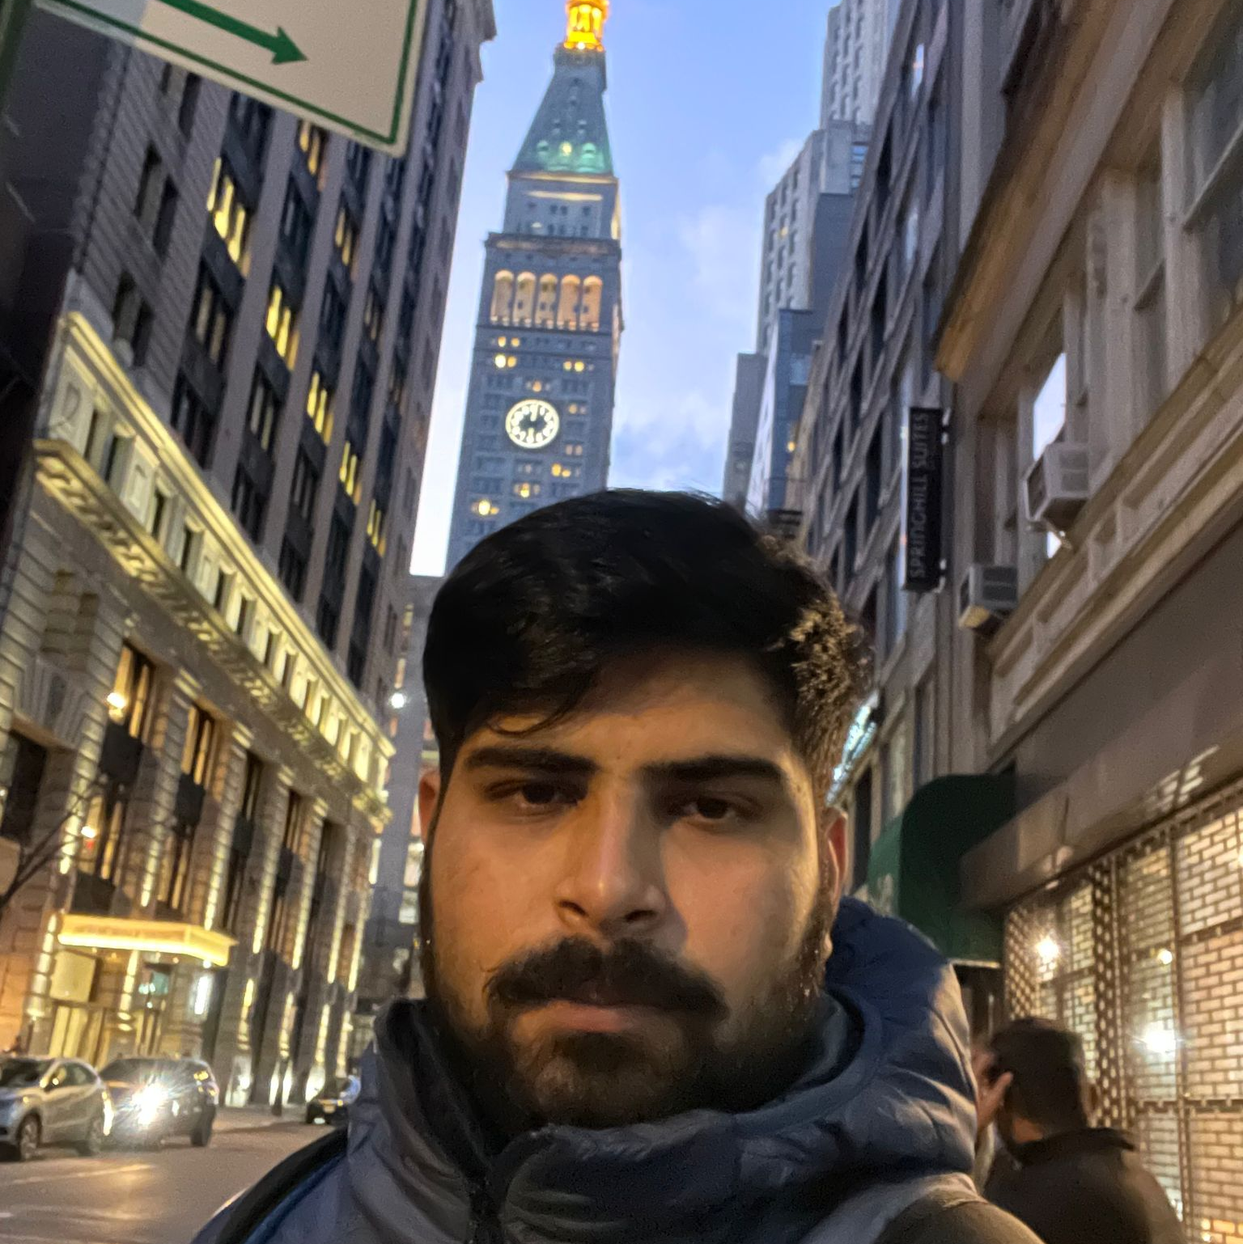


MEET OUR TEAM
SHIVANSH TOMAR
NIKHIL
JIGAR SHAH
DEVELOPER
QUALITY ANALYST ENGINEER
DEVELOPER

Slide 7
PROBLEM STATEMENT
Most hospitals are still facing several challenges with Hospital Management System because some of them are still using manual processes, while those who are using computerized method are also facing the challenge of adjusting to it. Like:
The high cost of software development and deployment.
Complex design in terms of User Interface and User Experience (UI/UX Design)
Fear of data security breach.
Difficulty in migrating from manual processes, because both staff and patients are used to the manual processes and so are unable to speedily cope with the new system.
Lack of IT-friendly medical personnel is also presenting several challenges.
A Huge influx of patients visiting government hospitals makes the process of migrating to automated processes highly difficult. They do not have the patience to wait for registration and data entry and often fail to understand the functioning of automated processes.

Slide 8
PROJECT DESCRIPTION
HMS helps to automate routine tasks, optimize staff coordination, improve communication, distribute the workload, store different types of information, and provide financial and HR management.
A hospital management system (HMS) is a tool that collects data about patients, doctors, staff, hospital administrative details in one software. One of the biggest advantages of developing a hospital management system is that it makes the whole process paperless.
Finances are another essential side of the hospitals. Apart from administrative, operational, and medical services, healthcare units must cope with billing and insurance operations. Integrating a financial system into a medical organization is vital for its sustainable financial performance.

Slide 9


Personas

Slide 10
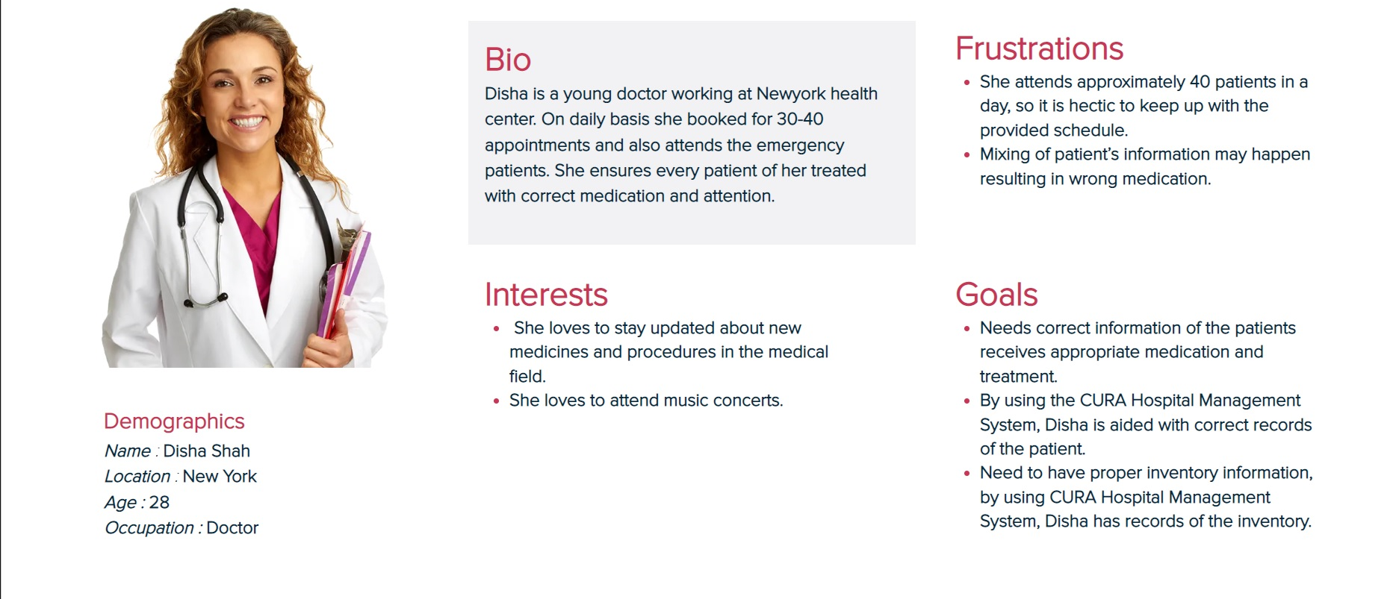
PERSONAS 1

Slide 11
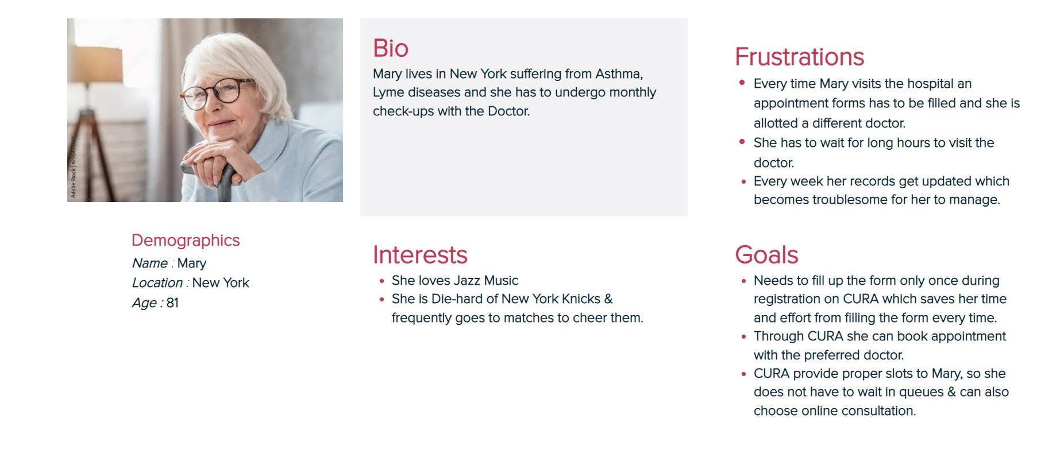
PERSONAS 2

Slide 12
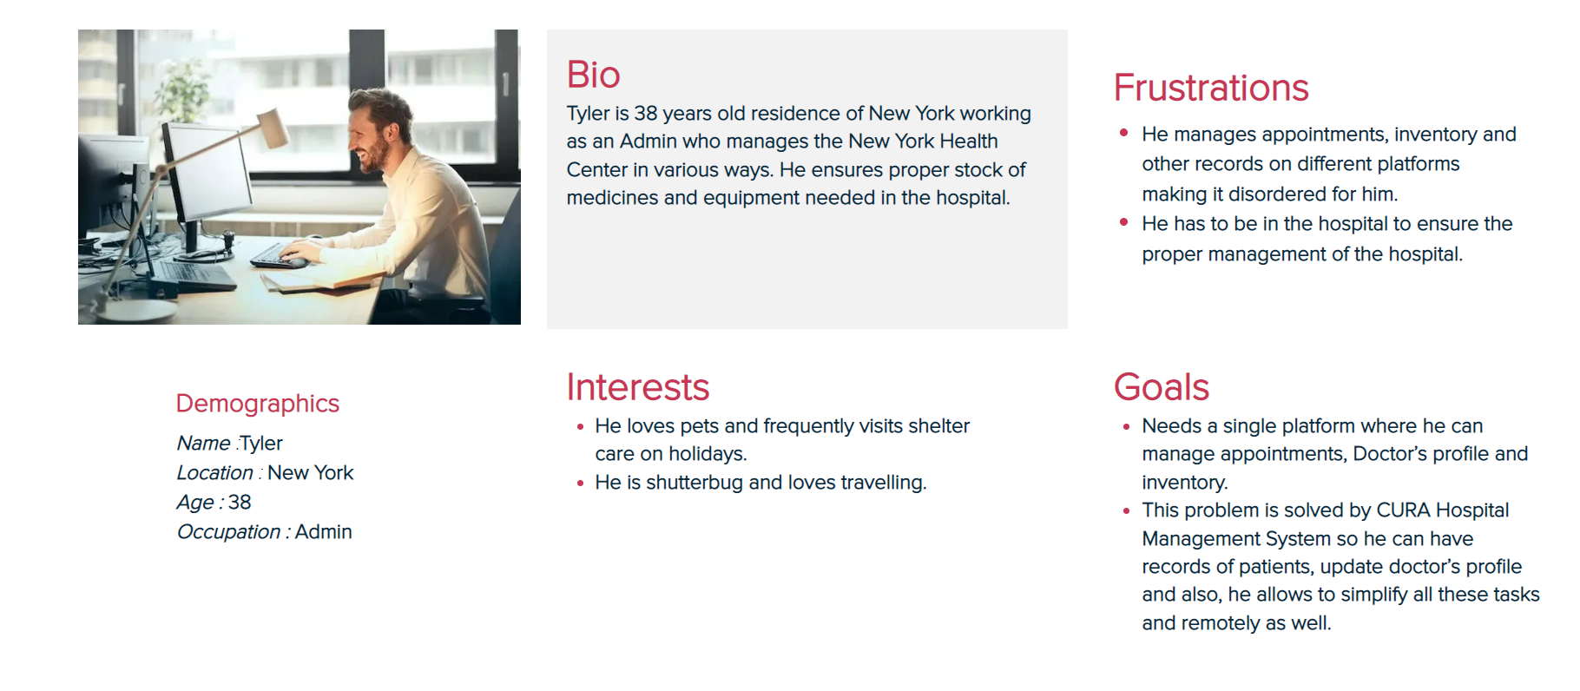
PERSONAS 3

Slide 13

Minimum viable product
REGISTRATION
User can register into CURA through this
LOGIN PAGE
User can log into CURA through this
HOME
User can surf through CURA features through this
User can plan his schedule using this and work accordingly
APPOINTMENTS
SCHEDULING
User can schedule his appointment with doctor through this

Slide 14








technologies
JAVA SCRIPT
CUCUMBER
GIT HUB

Slide 15

Conceptual Architecture Diagram

Slide 16
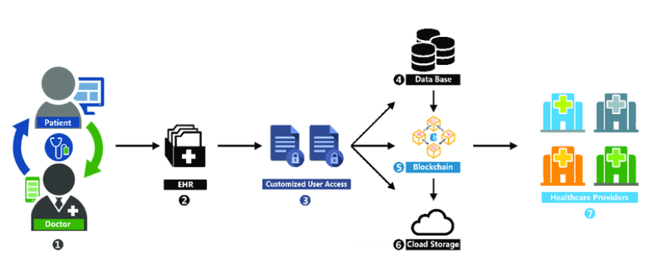
CONCEPTUAL ARCHITECTURE DIAGRAM

Slide 17
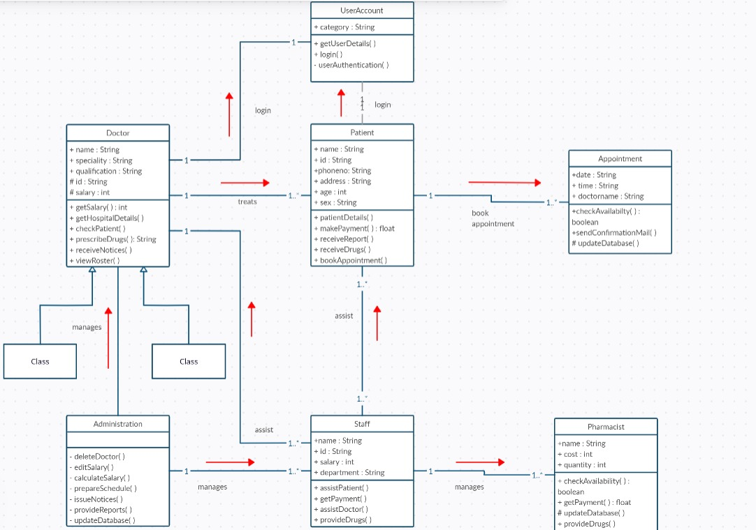
CLASS DIAGRAM of CURA

Slide 18
SPRINT RECAP

Slide 19
SPRINT 3 VS SPRINT 4
SPRINT 3
SPRINT 4
REGISTRATION
LOGIN
Appointments
SCHEDULE
Multiple features like add data
Created Proper UI

Slide 20

PRODUCT BACKLOG

Slide 21
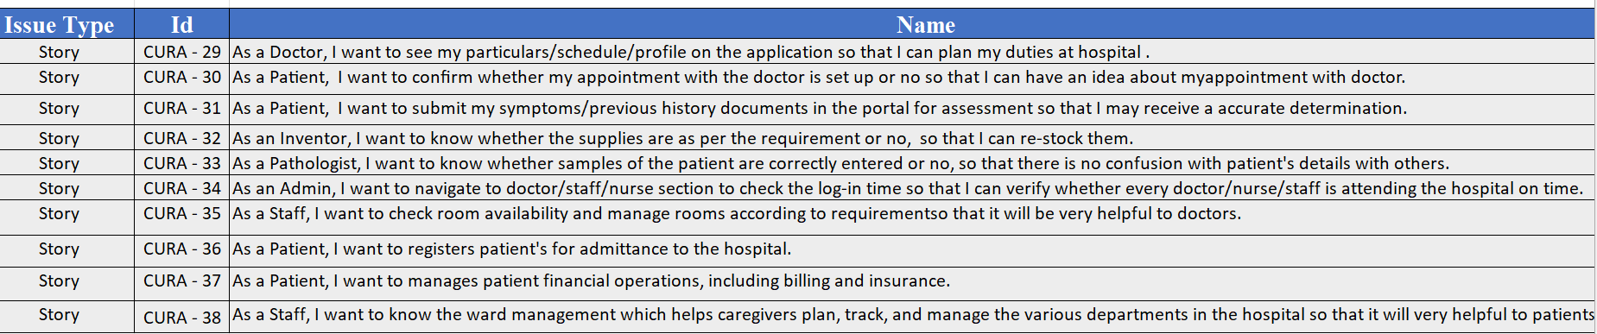

Slide 22
Sprint Backlog
Issue Type | Id | Name | Status
Story | CURA-16 | As a Patient , I would like to update my profile so that I can update my Name, Address, and Phone No. in it. | Done
Story | CURA-18 | As a Patient , I would like to book an appointment with a specific doctor so that will be easy to find solution for my problem. | Done
Story | CURA-20 | As a Patient, I would like to have a landing page that det ails all the advantages of the platform in order to encourage me to sign up. | Done
Story | CURA-25 | As a Doctor , I want to see appointment list so that I will get an idea how many patients book an appointment through portal. | Done
Task | CURA-26 | Final Technical Paper | Done
Story | CURA-27 | As a Pathologist I want to update the patient test details on portal | In Progress
Story | CURA-28 | As a Pathologist I want to create new patient id and upload his test results in portal. | In Progress

Slide 23
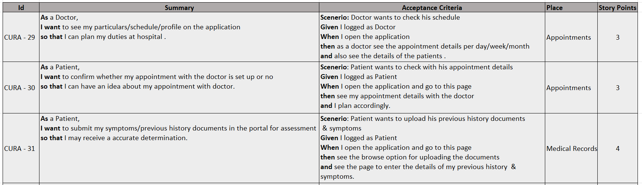
User Stories & Acceptance Criteria

Slide 24
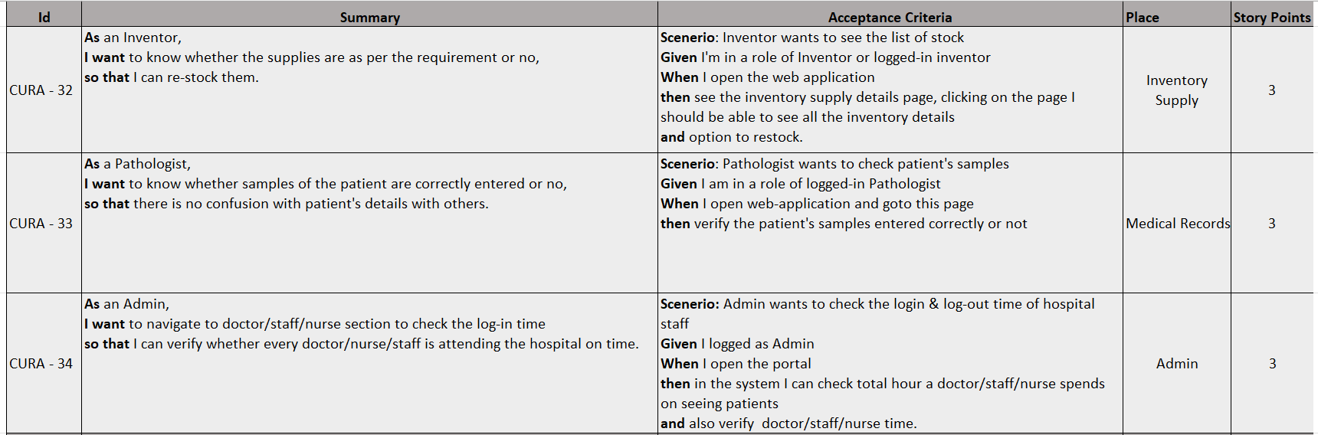
User Stories & Acceptance Criteria

Slide 25
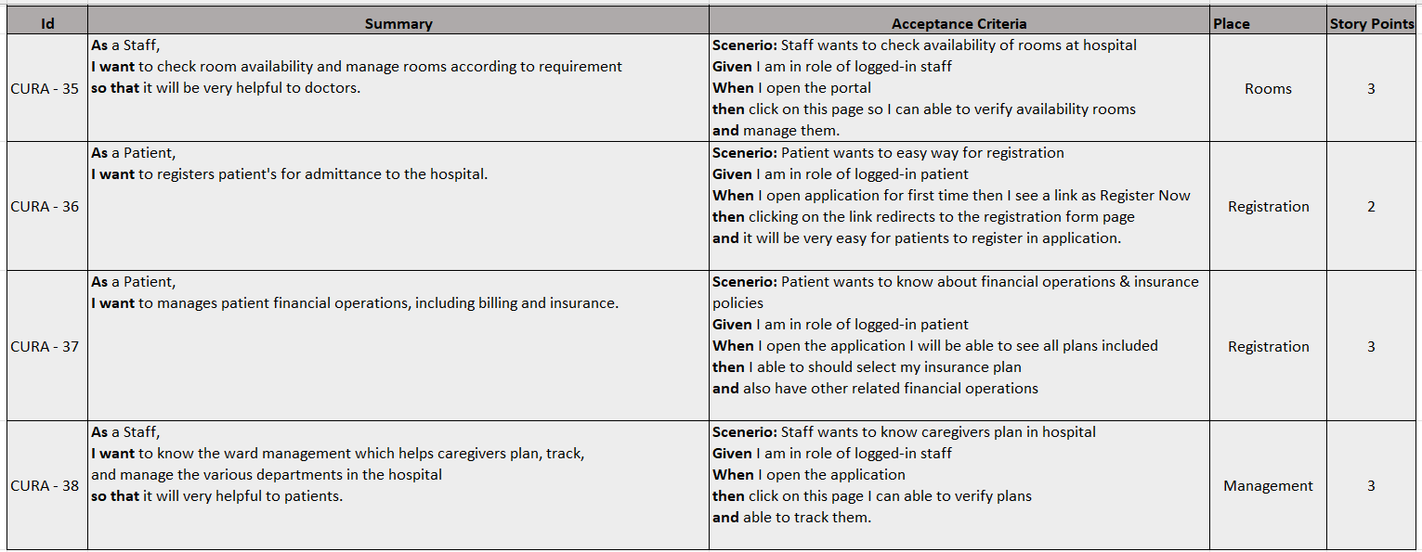
User Stories & Acceptance Criteria

Slide 26
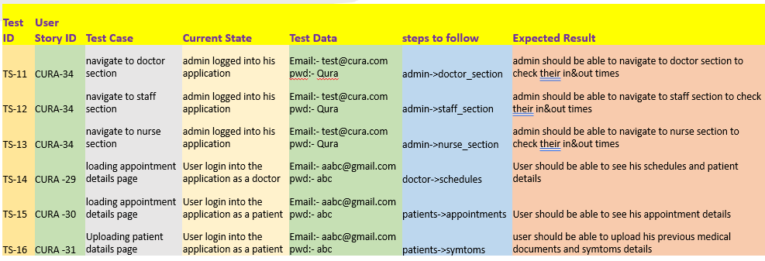
TEST CASES

Slide 27
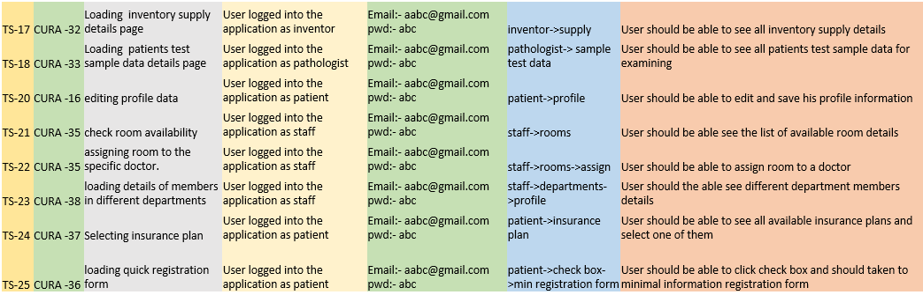
TEST CASES

Slide 28
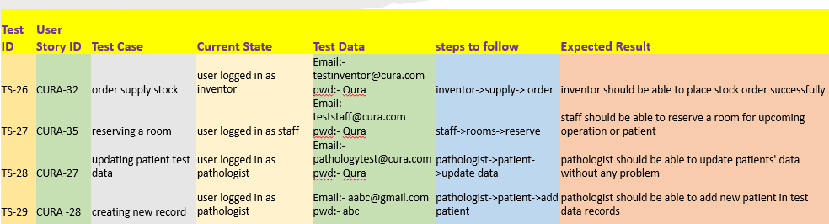
TEST CASES

Slide 29
Stories
Completed
Incomplete
As a Patient , I would like to update my profile so that I can update my Name, Address, and Phone No. in it.
As a Patient , I would like to book an appointment with a specific doctor so that will be easy to find solution for my problem.
As a Patient, I would like to have a landing page that det ails all the advantages of the platform in order to encourage me to sign up.
As a Doctor , I want to see appointment list so that I will get an idea how many patients book an appointment through portal.
As a Pathologist I want to update the patient test details on portal
As a Pathologist I want to create new patient id and upload his test results in portal.

Slide 30
METRICS

Slide 31
Team Velocity

Slide 32
Burndown chart

Slide 33
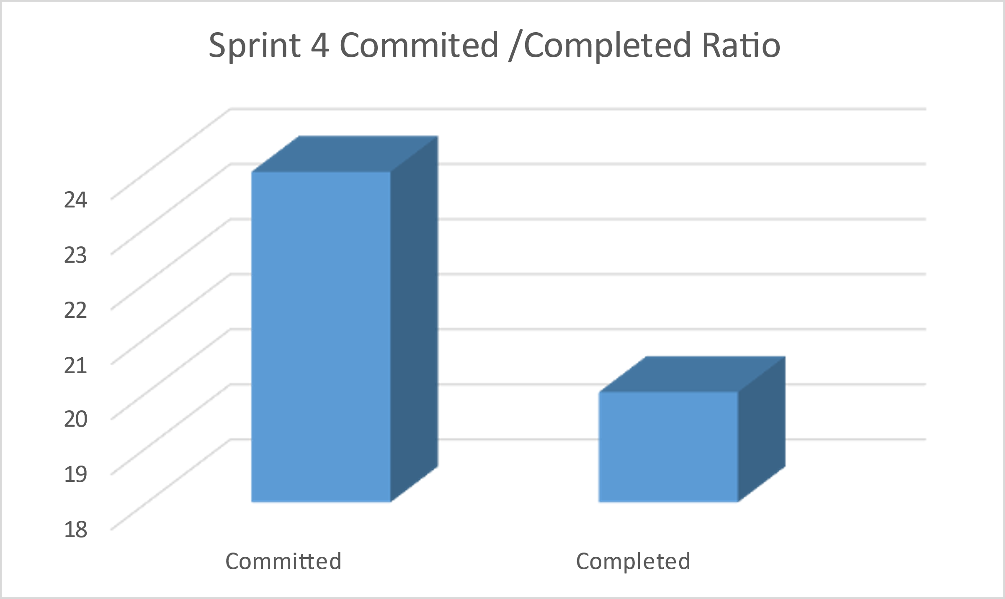
COMMITTED/ COMPLETED
RATIO

Slide 34
SPRINT 4 - STORIES PLANNED AND COMMITTED

Slide 35
RETROSPECTIVES
Retrospectives
What went well??
What didn't went well??
What next??
Team completed the task before due date.
Teammates being more responsible than previous sprint.
All teammates attended the meeting when team scheduled
Still some teammates are not actively participated in team meetings or chat groups.
Coping up with the technical skills
Collectively team will cross check the individual's work so that we can remove latency and teammates will work more actively.
Will improve the team coordination by scheduling the weekly status calls

Slide 36
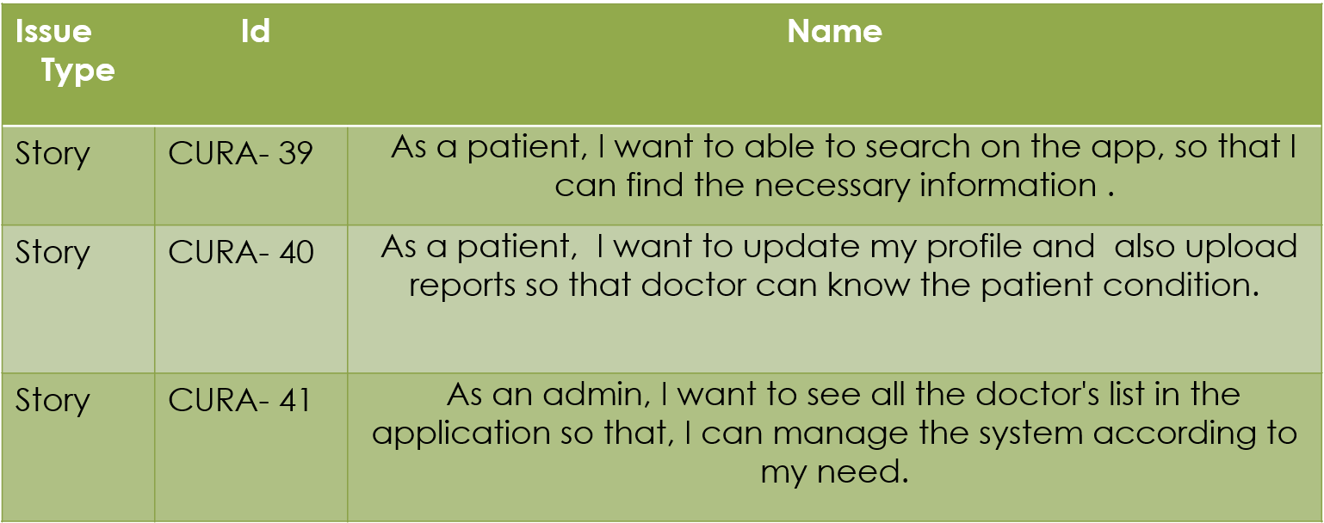
Sprint 5

Slide 37
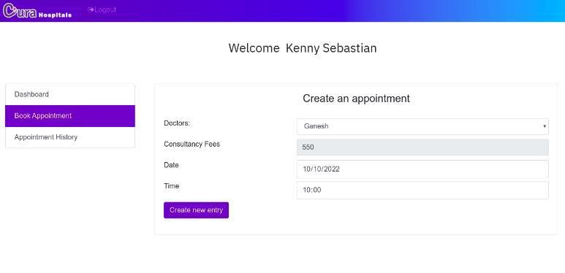
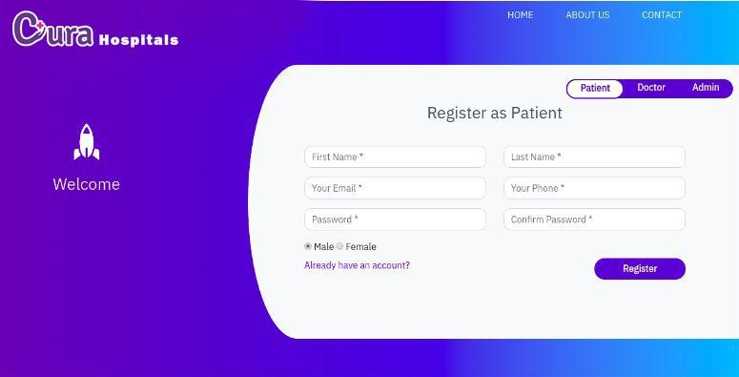
Application Screenshot

Slide 38

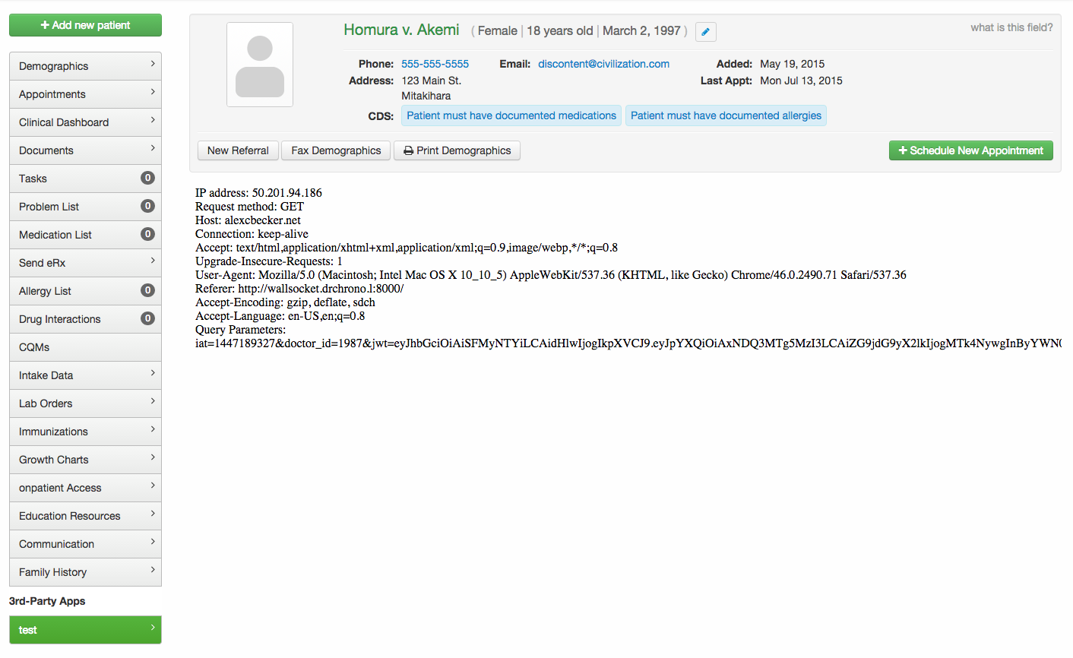

Api used

Slide 39

GITHUB LINK
https://github.com/SaiTejjj/HMS/wiki/CURA---HMS

Slide 40
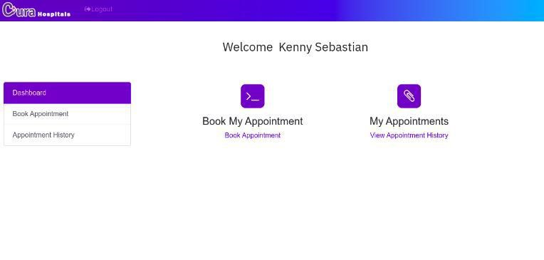
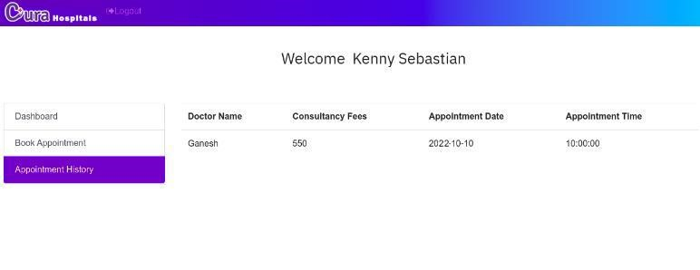
Live application demo

Slide 41

THANK YOU
Sai Teja Koribilli
Jigar Shah
Mounika Thalla
Kuldeep Raj
Bindu Valishetti
Nikhil
Shivansh Tomar

